Slide 1

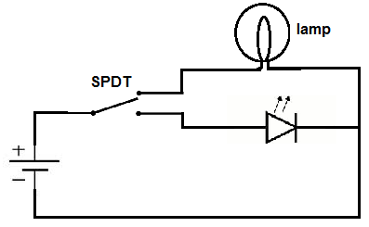
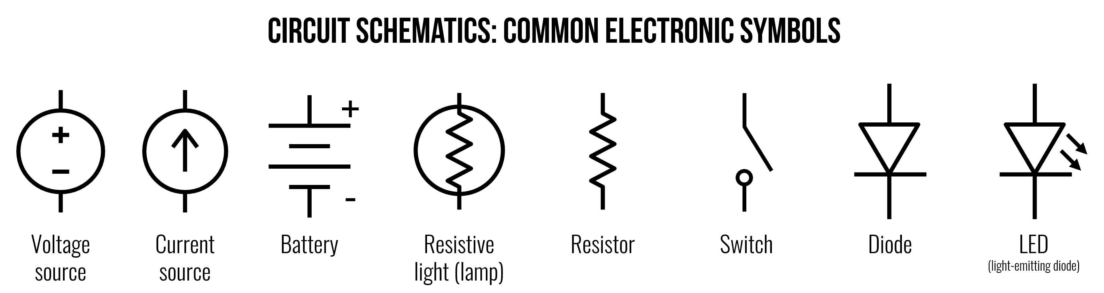
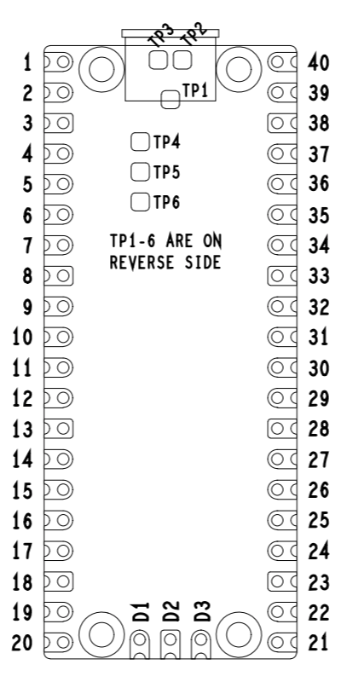
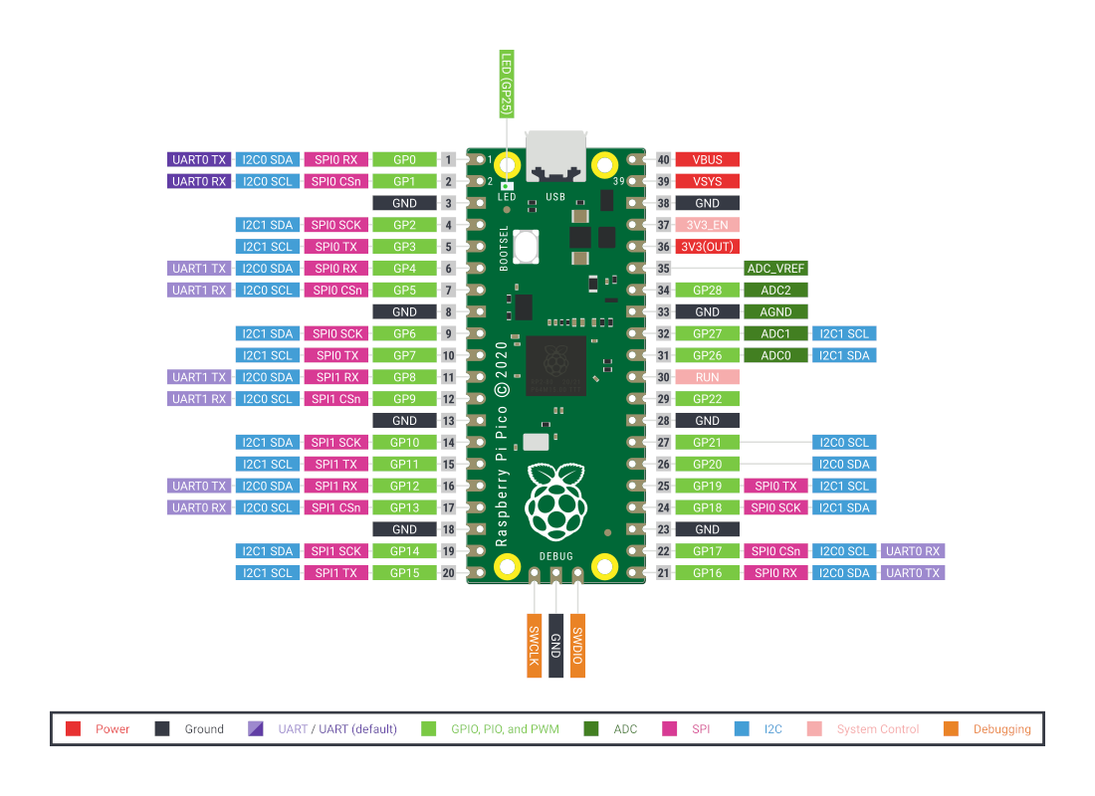
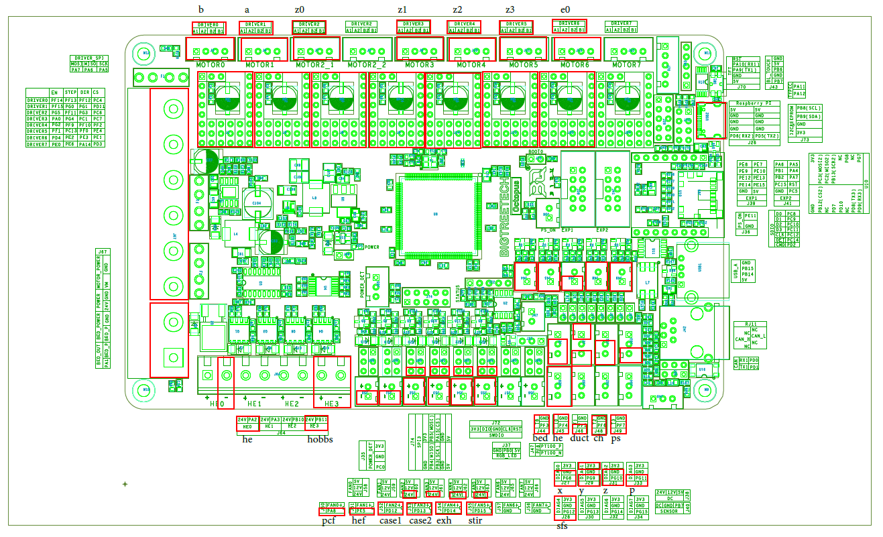


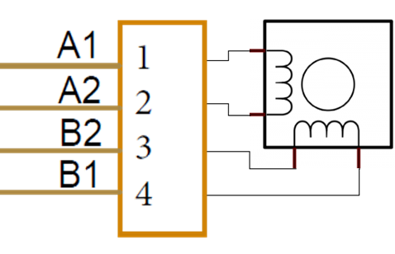
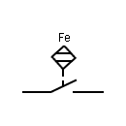
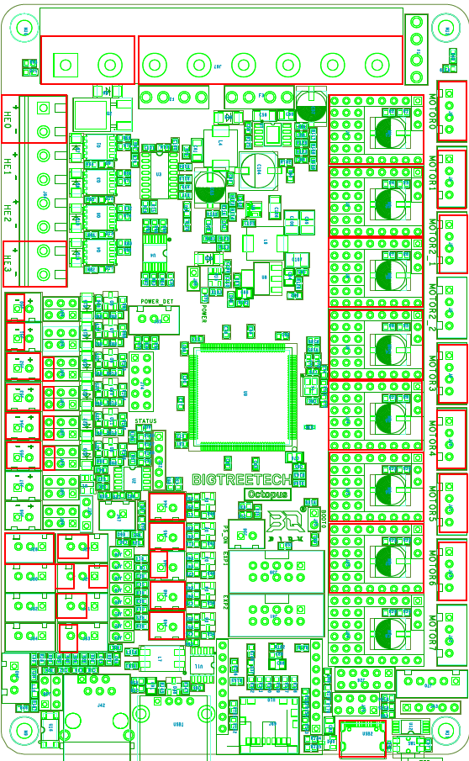
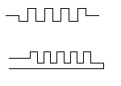

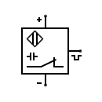
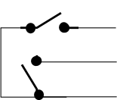
Inductive
Current Probe
Power
Meter
Temp Probe
110VAC
Power
Outlet
Sonoff S31 Outlet Tasmota-ized
Power
Inlet
I1
I2
H
N
T1
T2
Emergency
Stop Switch
Hot Neu Gnd
Hot Neu Gnd
AC
Power
Cord
Hot Neu Gnd
Fuse
Switch
Switched 5VDC Orange
Unswitched 5VDC
Red
NC
C
NO
In Out
C
NO
}
}
}
WiFi Logic Relay
Pwr Relay Module
DC Gnd
Black
Lamp +V
Gnd
+V
Sig
Gnd
TH 6
}
}
}
}
}
TH 3
AC Hot
Black
AC Neu
White
AC Gnd
Green
DC Gnd
Black
24VDC
Red
UnSw 5V 8A PS (Lights/ctl)
TH 4
Hot Neu AC Gnd
LED +5V DC Gnd
Front Skirt
Power Switch
TH 5
4.7K .1%
x
Sw 5V 4A PS (Pi RP2040)
NC
C
NO
Hot Neu AC Gnd
MCU +5V DC Gnd
Heatblock Thermistor
Red
Green
Blue
#1
DIN
Rail
24-5 DC Buck Converter for powering ERCF & ERCF Neopixels
#2
DIN
Rail
24-12 DC Buck Converter for powering Water Pump
Lamp Gnd
5VDC Powered 4 port USB 3.0 Hub (See Notes 3 & 4)
24V 8A PS
+V In Gnd In
4ea DOTSTAR LED Strips – 1 circuit 228 LEDs
Hot Neu AC Gnd
+24V +24V +24V DC Gnd DC Gnd
DC Gnd
+5VDC
Clock
Data ←
Gnd
+5VDC
Clock
Data ←
Gnd
+5VDC
Clock
Data ←
Gnd
+5VDC
Clock
Data ←
Gnd
ERCF 8x1 Neopixel Data
Back Left Front Right
This is milspec 24awg 4cond shielded ETFE wire MIL-W-27500-24SB4T23-3 Mfg by Raychem (TE)
SSR
In +
In -
Line Load
Bed
Heater Pad
Temp Bed
Disconnect
Bed Pwr Disconnect
Neu
1 1
ERCF EasyBrd
A A
Hot
TempSens
2 2
B B
Therm Fuse 1
Therm Fuse 2
Bed
Extrusion
Gnd Knife
Disconnect
Chassis Gnd
F M
~MHz Accelerometerized Tool Head PCB
Not Used
XES
Sig
Gnd
HE Temp
Sig
AGnd
SPI Signal Level
Shifters
24v->3v3 Power Supply
+24V CSEL
SCLK
MOSI
MISO
GND
1
2
3
4
5
6
7
8
9
10
11
12
13
14
15
16
17
18
1
2
3
4
5
6
7
8
9
10
11
12
13
14
15
16
17
18
N/C
Pico 2
Pico 4
Pico 5
Accelerometer Sensor
Circuitry on back of PCB
Pico 1
B
A
Z0
Z1
Z2
Z3
Duct Temp
Sig
AGnd
ABL
ABL(VSG) or Klicky(SG)
+24V
Sig
Gnd
Hour
Meter
HE0
+V Gnd
+24V
Sig
PCF
+24V
Sig
E0
HEF
+24V
Sig
Aft Chassis Fan
8x1 Neopixel (on ‘Dashboard’)
Fore Chassis Fan
BTT Smart Filament Sensor
5VDC PSU Fan
Chamber Exhaust Fan
3v3
Sig
Gnd
Chamber Filter/Stir Fans
X/Y End Stop PCB
Stepper
Driver Fan
Gnd
X Sig
Y Sig
3v3
Z End Stop PCB
(Mechanical)
Chamber Thermistor
Z Sig
Gnd
PSU Thermistor
(Mechanical)
Notes: 1) Klipper Host is an Acer Chromebox running Ubuntu 20.04.3
2) USB Nozzle Cam not shown
3) USB 3.0 Hub not shown (connects Host to MCU 1, MCU 2, Nozzle Cam) 4) Hub has power switches for each USB client device – MCU 2’s port’s power switch to
remain in the off position so it is powered down when the switched 5VDC power supply gets shut off

